Slide 1
Kansas Office of Broadband Development: Digital Equity + Broadband Equity Access and Deployment

Slide 2
The Kansas Office of Broadband Development (KOBD) was established in 2020 to help ensure all Kansans have the opportunity to live, work, learn, and compete in a global economy and by improving universal access to quality, affordable, and reliable broadband.
Mission

Slide 3
2022 Snapshot
Broadband Acceleration Grant 2.0
11 awards
$11.1 total invest including match
3,018 premises connected
Capitol Projects Fund
24 awards
$83.5M total grant awards
$125,343,656 total investment including match
1,834 businesses benefitted
25,567 premises to be connected

Slide 4
Broader Goals
Promotes the availability of reliable, broadband technology through stakeholder outreach and engagement
Advances the online accessibility of public resources and services
Promotes awareness of existing programs (e.g., Affordable Connectivity Program) that help low-income households afford broadband service Offers Internet equipment and software at low or no cost
Narrows adoption disparities across covered populations by engaging with diverse stakeholders Implements digital inclusion programs that include digital skills training, technical support and workforce development
Access
Affordability
Adoption & Equity

Slide 7
Why?*allKANSANS* what is the divide
Ranked 30th out of 50 states
Internet Speed
Coverage
Availability
Household Adoption
With Internet 85%
Without 15%

Slide 8
Why is Broadband Buildout Important?
Return on Investment
Cross Cutting Community Issue
Equity Issue
Notes:
The providers have stated where the return on investment is clear, those areas have been served. The remainder needs public-private partnership participation or provider incentives to close the gap. Local leadership is important for this reason.
It is a cross-cutting community vibrancy issue- education, economics, emergency services, and health access.
It is an equity issue. 21st Century services (including applying for jobs, submitting information for benefits, conducting telehealth visits, and so much more) all require broadband access. Those without access to broadband-- because it is not available in their area, they cannot afford the subscription, or they do not have or know how to use the technology-- are falling behind.
The investment match may come from the local governmental bodies, philanthropic means, provider investment, in-kind asset offerings, or a combination of all of the above.

Slide 9
Acknowledge the Tangle

Slide 10
Infrastructure Investment and Jobs Act
$65 BILLION - BROADBAND
Broadband Equity Access and Deployment (BEAD) Infrastructure
Digital Equity Act (DEA)

Slide 11
National Telecommunications and Information Agency (NTIA) Administers Two Programs for Every State and Territory Focusing on Access, Affordability, and Adoption
Broadband, Equity, Access and Deployment (BEAD): $42.45B
Amount of state investment based on the number of unserved or underserved locations-determined by assessing internet availability (baselined by FCC)
Universal service plan expected
Local planning required
Oversight to ensure compliance
5-Year Action Plan
Initial Proposal
Final Proposal
Digital Equity Act (DEA): $2.75B
3 grant programs to ensure the skills, technology, and capacity needed to reap the full benefits of our digital economy:
Planning: Develop Digital Equity Plan
Capacity: Implement Digital Equity Plan
Competitive: Develop and Implement Digital Inclusion Activities
Focuses on Covered Populations to ensure no one is left behind: veterans, older adults, rural inhabitants, people with disabilities, people with language barriers, racial and ethnic minorities, incarcerated individuals, and low-income households

Slide 12
Community Engagement in the BEAD and DE Programs
Ensure equity is the central component
Reduce the burden and confusion
Develop robust, inclusive plans
Bead
PROGRAM
Digital equity
Planning grant
program
Collaboration & coordination

Slide 13
Every stakeholder plays a role in the BIL programs
Illustrative, non-exhaustive
Community anchor institution
Partner with States, other territories, and Tribal / Native entities to develop State Digital Equity Plans
Advocate for community interests and needs
Community orgs
Serve as a thought partner as States, other territories, and Tribal / Native entities design their outreach strategies
Advocate for community interests and needs
Telecom provider
Provide States, other territories, and Tribal / Native entities with background data on their baseline and digital equity needs
Tribal government
Submit a letter of intent to participate in the DE Planning Grant Program
Coordinate with relevant State(s) to develop state-wide Plans
Local government
Collaborate with States, other territories, and Tribal entities to develop State Digital Equity Plans
Individual
Participate in the planning process of your local jurisdiction

Slide 14
Digital Equity defined by Kansas Office of Broadband
What does Digital Equity mean?
Digital equity is a condition in which all individuals and communities have the information technology capacity needed for full participation in our society, democracy and economy.
-National Digital Inclusion Alliance

Slide 15
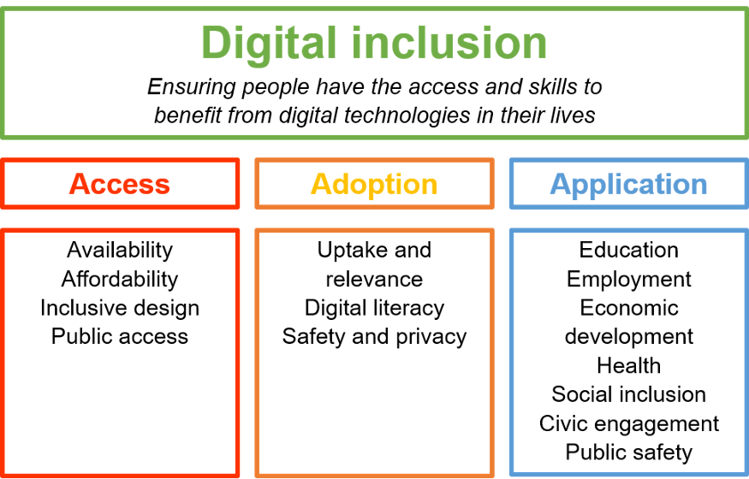
Language
Broadband Equity Access and Deployment (BEAD) + Digital Equity Act (DEA)
Notes:
Digital Equity (What)
NDIA: The condition in which all individuals and communities have the information technology capacity needed for full participation in our society, democracy, and economy
Digital Inclusion (How)
Includes affordable connectivity, devices, and digital skill literacy
The activities necessary to ensure that all, including most disadvantaged, have access to robust broadband connections, internet-enabled devices that meet their needs; and the skills to explore, create and succeed in the digital world
Digital Adoption ( Are they Connected)
Individuals and groups who have access to broadband and choose to subscribe to broadband
Digital Application (Education)
An ability to find, evaluate, and clearly communicate information through typing and other media on various digital platforms

Slide 16
Digital Equity + BEAD planning phases will be congruent

Slide 17
2023 Strategic Goals | DE + BEAD
Community Engagement
Asset Mapping
Digital Equity + BEAD Plan
Strategic Planning
Digital Equity
BEAD Plan
Competitive Capacity Grants
2024

Slide 18
Grants for buildout
begin
NTIA Planning Funds Received by State
FCC Broadband Fabric Map Released
(Challenges Begin)
Challenge Period Ends
Final Broadband Fabric Map Approved
BEAD Funds Allocated Based on Final Map
BEAD 5 Year Action Plan Due
+270 days from Planning Funds Received
DEA 5 Year Action Plan Due
+12 months from Planning Funds Received
BEAD Initial Proposal Due
+ 180 days from funding allocation
BEAD Initial Proposal Approved- 20% BEAD Funding Awarded
BEAD Final Proposal Due
+12 months from Initial Proposal Approved
BEAD Final Proposal Approved-80% BEAD Funding Awarded
BEAD and Digital Equity Timeline and Deliverables
4Q22
11/18/22
01/13/23
5/2023
6/30/2023
8/2023
11/2023
12/30/2023
12/23-1Q24
12/24-1Q25
1Q25
Digital Equity Plan Approved
Funding Received
State Digital Equity Projects Commence
These plans are integrated even though timelines are different

Slide 19
How does this impact me and my community?
Engagement
Asset mapping
Planning
Federal Government
State Government
Together
BEAD & DEA
5 year plan
Funding from BEAD & DE
Plan review
Communities
Competitive grant process
Notes:
Kansas Office of Broadband Development with their consultant, Solarity, is building out the related BEAD and DEA programs (use full names of programs). Solarity is responsible for developing a 5-Year Action Plan to submit to the NTIA (National Telecommunications and Information Administration) in a few months to secure estimated funding of at least $100M to ensure universal broadband access in the state of Kansas. Currently, it looks like Kansas will receive around $350million for BEAD grant funds.
NTIA (National Telecommunications Information Association) administering these two programs​
Rules issued to states outlining how to qualify and participate in funding​
Kansas in line to receive approximately $500M​
Strict reporting will be in place to ensure compliance to program requirements​
State identifies all underserved and unserved areas ​
FCC Broadband Fabric Map is the baseline of acknowledged areas​
State will work with residents and businesses to validate this map ​
Public map to be published so that personal addresses can be verified​
State challenge process to allow for errors to be corrected​
KOBD works with consultant partner, Solarity, to conduct outreach ​
State Agencies, Providers, Economic Development Groups, City and County Leadership, Non-Profit Organizations, and Citizens​
State needs are determined and aggregated into 5-Year Plans ​
State submits plans to NTIA for approval and funding​
Communities, Counties, and Regions plan with Provider partners​
State issues grants ​
Applications awarded based on strict criteria ​
Milestones to ensure progress and completion

Slide 20
Digital inequity disproportionally impacts our stakeholders
DE & BEAD
Covered Populations and Underrepresented Communities
Identity groups and communities disproportionally impacted by digital inequity
 | Low-income households
 | Aging individuals
 | Incarcerated individuals
 | Veterans
 | Persons of Color
 | Indigenous and Native American persons
 | Members of ethnic and religious minorities
 | Women
 | LGBTQI+ persons
 | Persons with disabilities
 | People with language barriers
 | Racial and ethnic minorities
 | Rural inhabitants
 | Persons adversely affected by persistent poverty or inequality
DE NOFO
BEAD NOFO

Slide 21
Our ask to you:

Slide 22
Commit to Connect:
DE & BEAD Plans
Community Champions
Assets
Barriers
Listening Sessions
Meeting Spaces

Slide 23
Looking for a Team Approach:
Economic Development/Workforce
Library/Museum
Local Governments
School/Education Sectors/Faith Based organizations
Housing Authorities
Organizations Serving Covered Populations
Broadband Community Champions

Slide 24
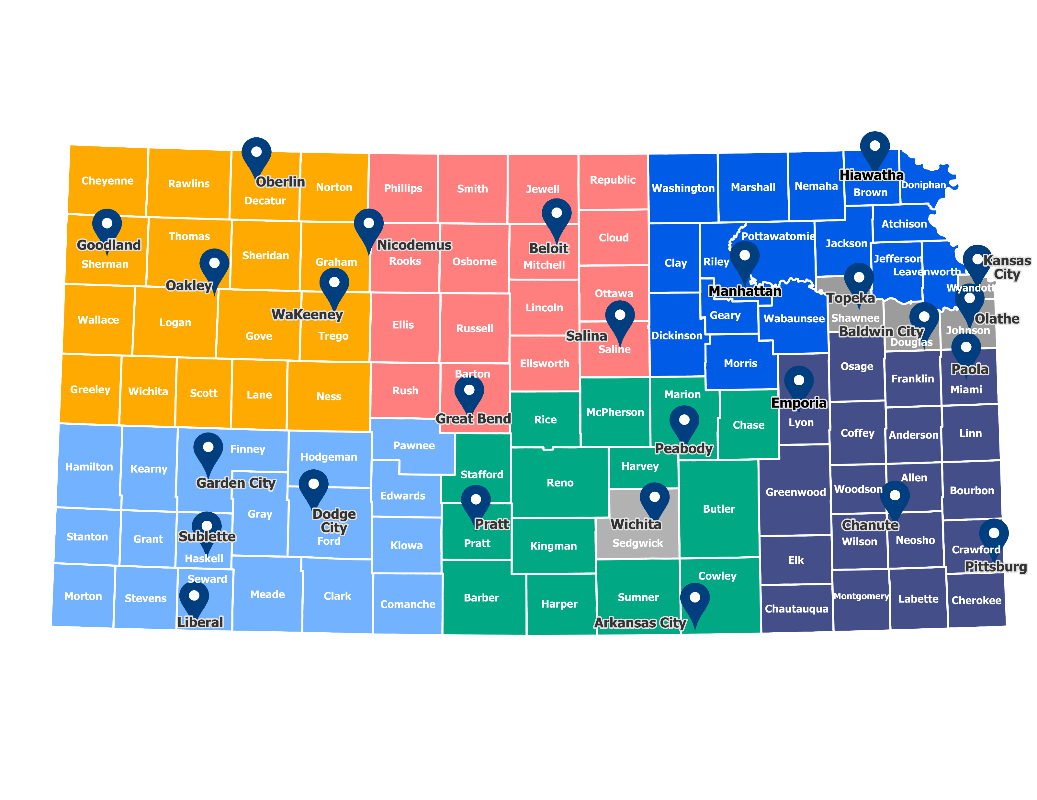

Slide 25
Local Leadership Can….
Prioritize this effort
Build relationships
Creative funding
Notes:
Priotize this effort: KOBD and their consultants will be reaching out to you to help gather the County Commissioner and others to meet and discover information for BEAD/DEA.
Build Relationships
KOBD and their consultants will be reaching out to you to help gather the County Commissioner and others to meet and discover information for BEAD/DEA
Funding: Take a look at your current funding streams to see if funds can be used for projects now or for project match requirements in the future. For example, are there any ARPA allocations remaining? If you are not sure, please ask.
Invest match opportunities
Government bodies
Philanthropic means
Provider investment
In-kind asset offerings,
Combo-not a one size fits
Statewide Expanded Definition of Anchor Institutions​
Drives for 1Gbs connectivity to each location​
Acknowledges importance of community support​
Supports increased Telehealth availability​
Ensures full educational availability​
Short term fix to physical infrastructure shortfalls​
​
Economic Development Driven by Broadband Improvements​
Population “stays in”, “returns to”, or “joins” the communities due to ease of operating globally via broadband​
Employers' workforce pool expands due to more citizens with remote working capabilities​
Businesses relocate due to ease of operations​
Jobs created in remote working, broadband deployment, training, and technical support​
​
Healthcare extended in rural and urban areas​
Telehealth allows for 100% participation​
Cost to serve Medicaid patients reduced due to remote monitoring, information sharing, and compliance​
​
Education Equity ​
Adult continuing education​
Student online education​
​
Social Services​
Easier enrollment access and compliance​
Possible administration consolidation

Slide 26
Community Readiness
Core Group
Establish Goals and Measure Success
Build a Community Movement
Evaluate the Now
Policies, Procedures and Regulations
You are the Driver
Notes:
Priotize this effort: KOBD and their consultants will be reaching out to you to help gather the County Commissioner and others to meet and discover information for BEAD/DEA.
Build Relationships
KOBD and their consultants will be reaching out to you to help gather the County Commissioner and others to meet and discover information for BEAD/DEA
Funding: Take a look at your current funding streams to see if funds can be used for projects now or for project match requirements in the future. For example, are there any ARPA allocations remaining? If you are not sure, please ask.
Invest match opportunities
Government bodies
Philanthropic means
Provider investment
In-kind asset offerings,
Combo-not a one size fits
Statewide Expanded Definition of Anchor Institutions​
Drives for 1Gbs connectivity to each location​
Acknowledges importance of community support​
Supports increased Telehealth availability​
Ensures full educational availability​
Short term fix to physical infrastructure shortfalls​
​
Economic Development Driven by Broadband Improvements​
Population “stays in”, “returns to”, or “joins” the communities due to ease of operating globally via broadband​
Employers' workforce pool expands due to more citizens with remote working capabilities​
Businesses relocate due to ease of operations​
Jobs created in remote working, broadband deployment, training, and technical support​
​
Healthcare extended in rural and urban areas​
Telehealth allows for 100% participation​
Cost to serve Medicaid patients reduced due to remote monitoring, information sharing, and compliance​
​
Education Equity ​
Adult continuing education​
Student online education​
​
Social Services​
Easier enrollment access and compliance​
Possible administration consolidation

Slide 27
Grant or Program Opportunity | Resource
SPARK (LINC) – open very soon | Kansas Department of Commerce, Office of Broadband Development
State of Kansas Broadband Acceleration Grant (late Spring 2023) | Kansas Department of Commerce, Office of Broadband Development
Digital Connectivity Technology Grant | Kansas Department of Commerce, Office of Broadband Development
Enabling Middle Mile Broadband Infrastructure | National Telecommunications and Information Administration
Broadband Equity, Access, and Deployment (BEAD) | National Telecommunications and Information Administration
Digital Equity (DE) | National Telecommunications and Information Administration

Slide 28
Grant or Program Opportunity | Resource
Tribal Broadband Connectivity Program | National Telecommunications and Information Administration
USDA ReConnect Grant Program | US Department of Agriculture
Affordable Connectivity Program | Federal Communications Commission
Internet for All | The White House

Slide 29
State Program – $35 million – ARPA dollars SPARK (Strengthening People and Revitalizing Kansas )
$30 million – LINC
(Lasting infrastructure and Network Connectivity)
The purpose of LINC is to provide competitive grants to enable the deployment of last mile and middle mile broadband infrastructure in areas of the state that lack access to high-speed internet service.
Sliding scale match-based on rurality.
$5 million – DECK
Digital Equity to Connect Kansans
Purpose of DECK is to provide devices, adoption, etc. programs to enhance digital equity

Slide 30
DE Terms + Funding Opportunities
Digital
Equity
Robust Infrastructure
Appropriate Devices
Affordable Connectivity
Digital Literacy Skills
Funding Opportunities - Devices
Affordable Connectivity Program
Digital Connectivity Technology
Digital Equity Competitive Grant
Digital Equity Planning Grant
Digital Equity Capacity Grant
Funding Opportunities - Infrastructure
Broadband Access Equity and Deployment (BEAD)
Broadband Acceleration Grant
Funding Opportunities – Affordable Connectivity
Affordable Connectivity Program
Digital Connectivity Technology
Digital Equity Competitive Grant
Digital Equity Planning Grant
Digital Equity Capacity Grant
Funding Opportunities – Digital Literacy Skills
Digital Connectivity Technology
Digital Equity Competitive Grant
Digital Equity Planning Grant
Digital Equity Capacity Grant

Slide 31
Project Priorities
Matching Funds Beyond Minimum Requirement
Unserved Areas
Underserved Areas
Fiber-optic Infrastructure
Economically Distressed
Affordability
Speeds
Rurality
Scalability
Partnerships

Slide 32
Eligible Applicants
Corporations
Non-profit organizations
Tribal
Those authorized to provide broadband services in the proposed service area
Eligible Applicants
Political subdivisions or entities of political subdivisions
Partnerships or other business entities
Electric Utilities

Slide 33
Ineligible Costs
Obligation / Debt Servicing
Satisfaction of any obligation
Payment of interest or principal on outstanding debt instruments
Operational Expenses
Operating expenses
Short-term operation leases
Maintenance expenses related to the project.
Indirect labor costs (fringe/benefits, travel, meals, lodging, paid time off, etc.)
Capital Assets / Infrastructure
Acquisition of spectrum licenses
Infrastructure not directly connected to service provision for an end-user in the proposed area
Long-term capital asset purchases/leases, although cost allocation for use during the project period will be considered on a case-by-case basis

Slide 34
Application Submission Structure +
Project Proposal
Executive Summary of the Project
Service Area Maps
Public Map
Private Map
Community Partners, Roles & Letters of Commitment
Justification for the Project
Adoption, Affordability, and Digital Inclusion Efforts (ACP participation required)
Financials
Technical Project Summary
Technical Project Plan
Network Architecture
Public and Proprietary Detailed Map of the Proposed Area
List of Census Block Address Identifiers
Project Plan and Milestones
Long Term Investment Viability
Budget Narrative
Project Budget Spreadsheet
Financial Validation Documentation

Slide 35
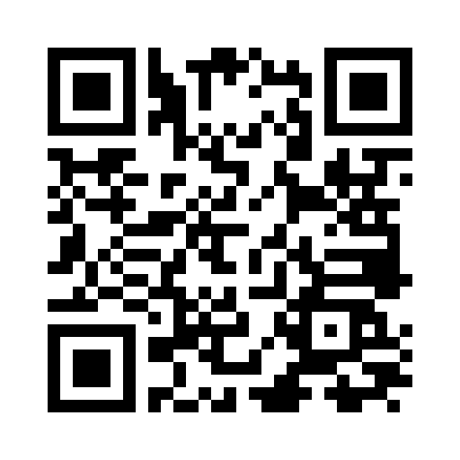
KOBD Team Jade Piros de Carvalho | jade.piros@ks.gov Joseph Le | joseph.le@ks.gov Kimberlyn Jones | kimberlyn.jones@ks.gov Morgan Barnes | morgan.a.barnes@ks.gov Stephen Shelton | Stephen.shelton@ks.gov
Josh Edgar | joshua.edgar@ks.gov
Casey Russell | casey.russell@ks.gov
Scan to sign up for Broadband Newsletter

