Slide 1


Slide 2
Kansas County Commissioners

Slide 3
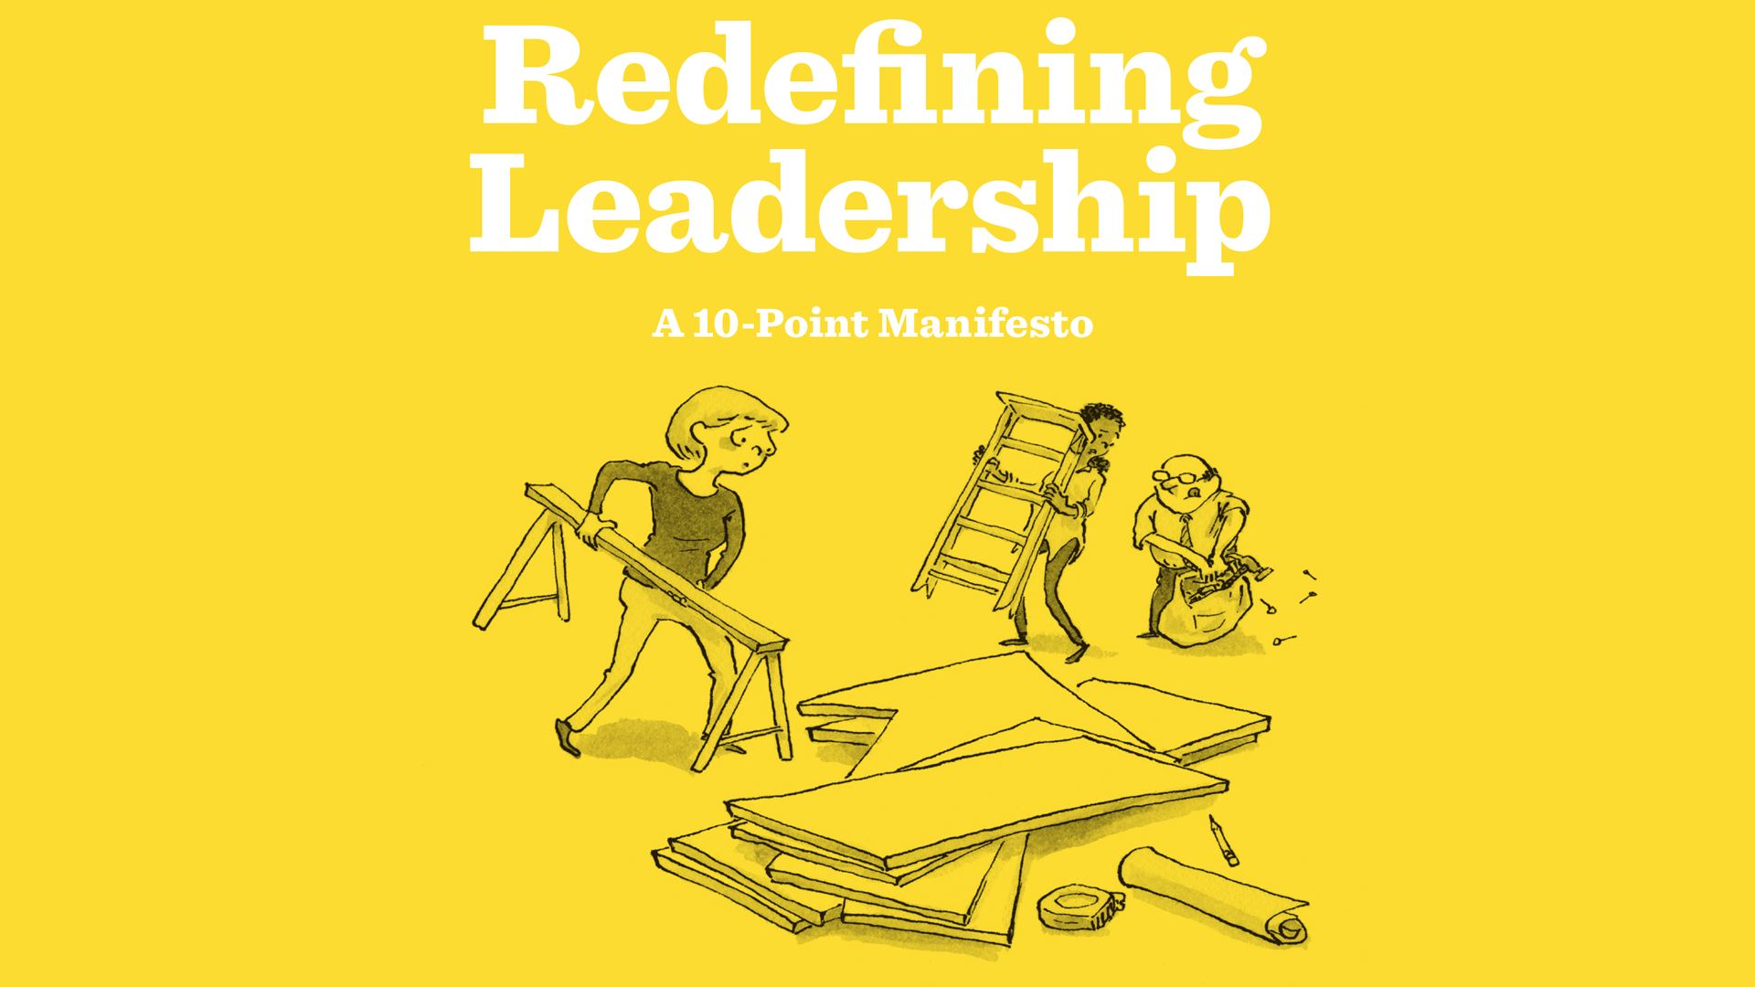
Notes:
Read experts through heading on page 17
Manifesto then KLC intro

Slide 4
1.
Tough challenges are all around us.

Slide 5
2.
Most think leadership is a position. (It’s not.)

Slide 6
3.
Leadership isn’t…
Authority. Being the boss. Vision. Charisma. A servant’s heart. An inspirational speech.

Slide 7
4.
Imagine if people thought about practicing leadership, rather than “being a leader.”

Slide 8
5.
Plenty of people in important positions never exercise leadership.

Slide 9
6.
So, most of us don’t lead.

Slide 10
7.
Leadership is an activity, not a position or authority.

Slide 11
8.
If anyone can lead, then everyone can lead.

Slide 12
9.
Leadership is risky.

Slide 13
10.
It’s not leadership if it’s not about our most important challenges.

Slide 14
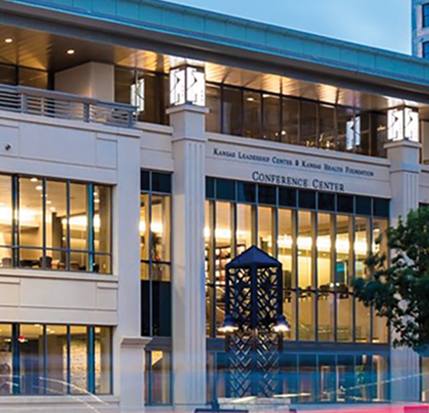


Slide 15
When everyone leads, we make progress on our most important challenges.

Slide 16
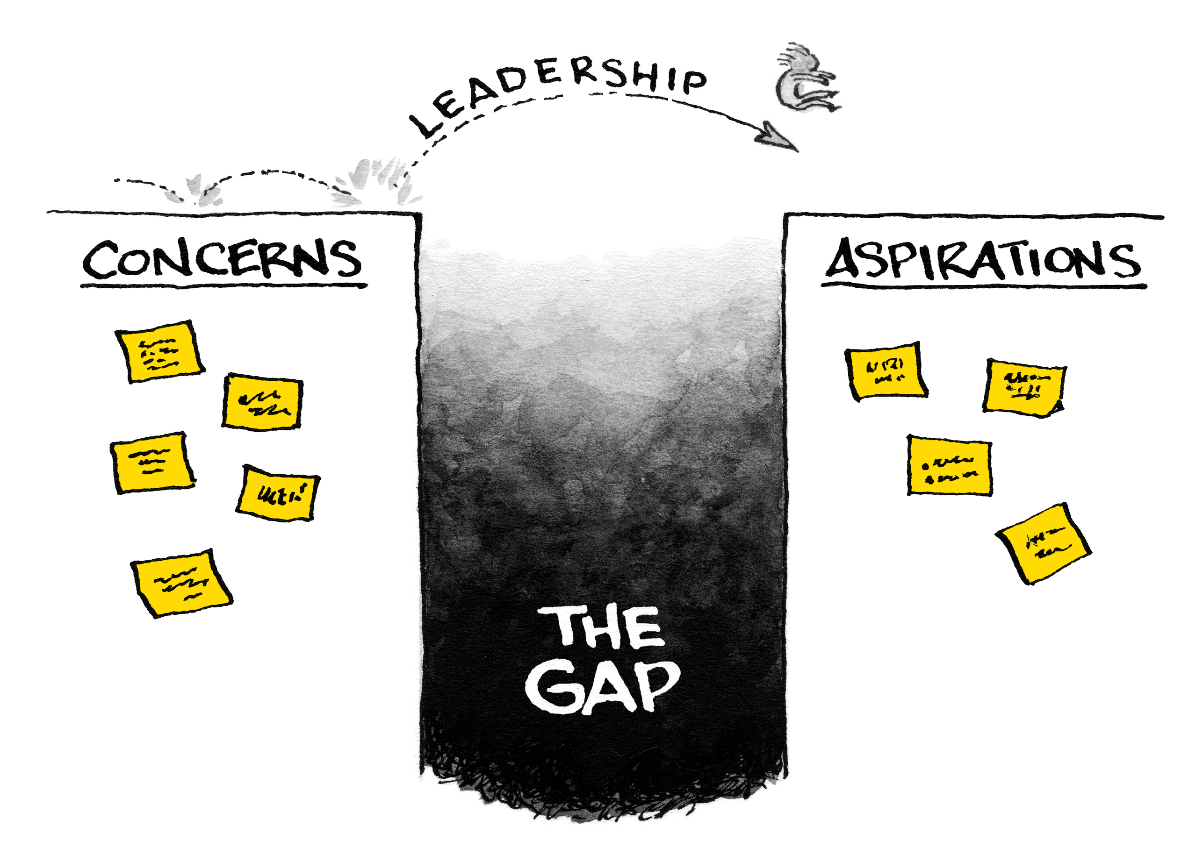
Notes:
We all feel the gap
What makes it so hard
We’ve discovered 5 key barriers
Barriers to leadership:
1.Our toughest challenges involve loss – people don’t fear change –
If a wealthy donor swept in a said they were providing full scholarships for every Chase County kid to attend a regents university, community or technical college – we’d applaud that change; But we hate the change that comes with loss
But more often change comes with loss – a live local example was the closing of our historic elementary school ## years ago
And that’s hard to accept because (page 71)
• Authorities tell us we can have our cake and eat it
too. We’ve grown accustomed to politicians telling us
we can have all upside and no downside. We want to believe
it’s possible.
• People in authority are not trained to help others
navigate loss. They lack skills like speaking
with empathy, deep listening, and knowing how to
pace the change.
• We are conditioned to avoid the negative. We focus
on the rosy change, not the unfortunate loss. We don’t let
our minds go there.
• We hate disappointing people. We don’t want to create
conflict or stoke anger. Helping others face loss takes
courage we don’t have.
• Sometimes the loss is our own. For example, for your
organization to refocus on its mission, you might have to
let go of a program or a piece of your role that defines you.
When the challenges are adaptive, no one gets a free pass.
Authority is never enough
Leadership is risky My grandmother boarded a ship. Her purpose what that important. Don’t exercise leadership unless your vision for south central Kansas is powerful enough …
Values class when you seek to close The Gap – page 83 –
When everyone leads, people at all levels in your organization,
community, or family feel empowered to name those
hidden priorities. They look for moments to ask questions
about whether the group is walking its talk. Everyone
feels compelled to do what they can to develop a common
understanding of what matters most. When everyone
leads, we stop depending on the person in authority to see
everything, catch every misalignment, and say all the
hard things.
Quick fixes don’t work

Slide 17
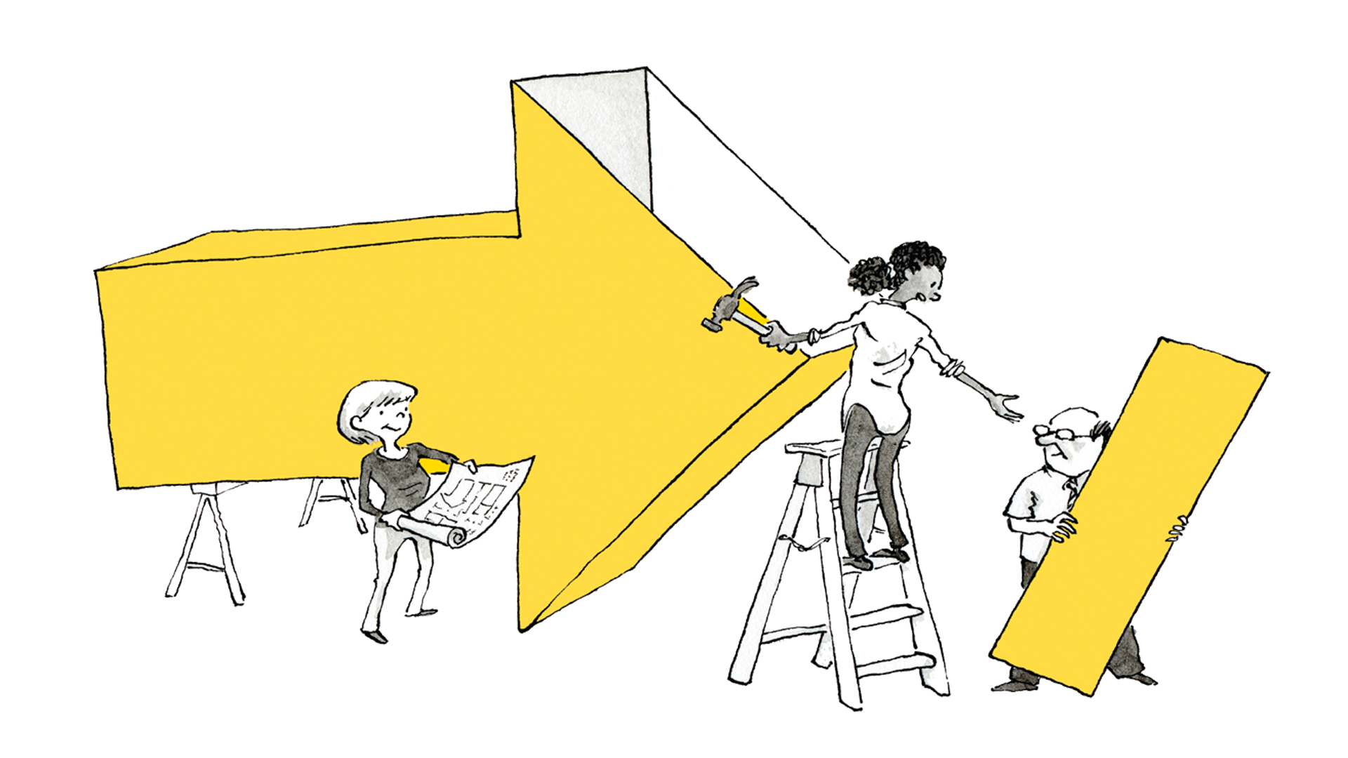
When Everyone Leads
When you think about the future (of your organization, company, community, or family) what is your boldest aspiration?
Notes:
If that’s what we want, how do we get started?

Slide 18
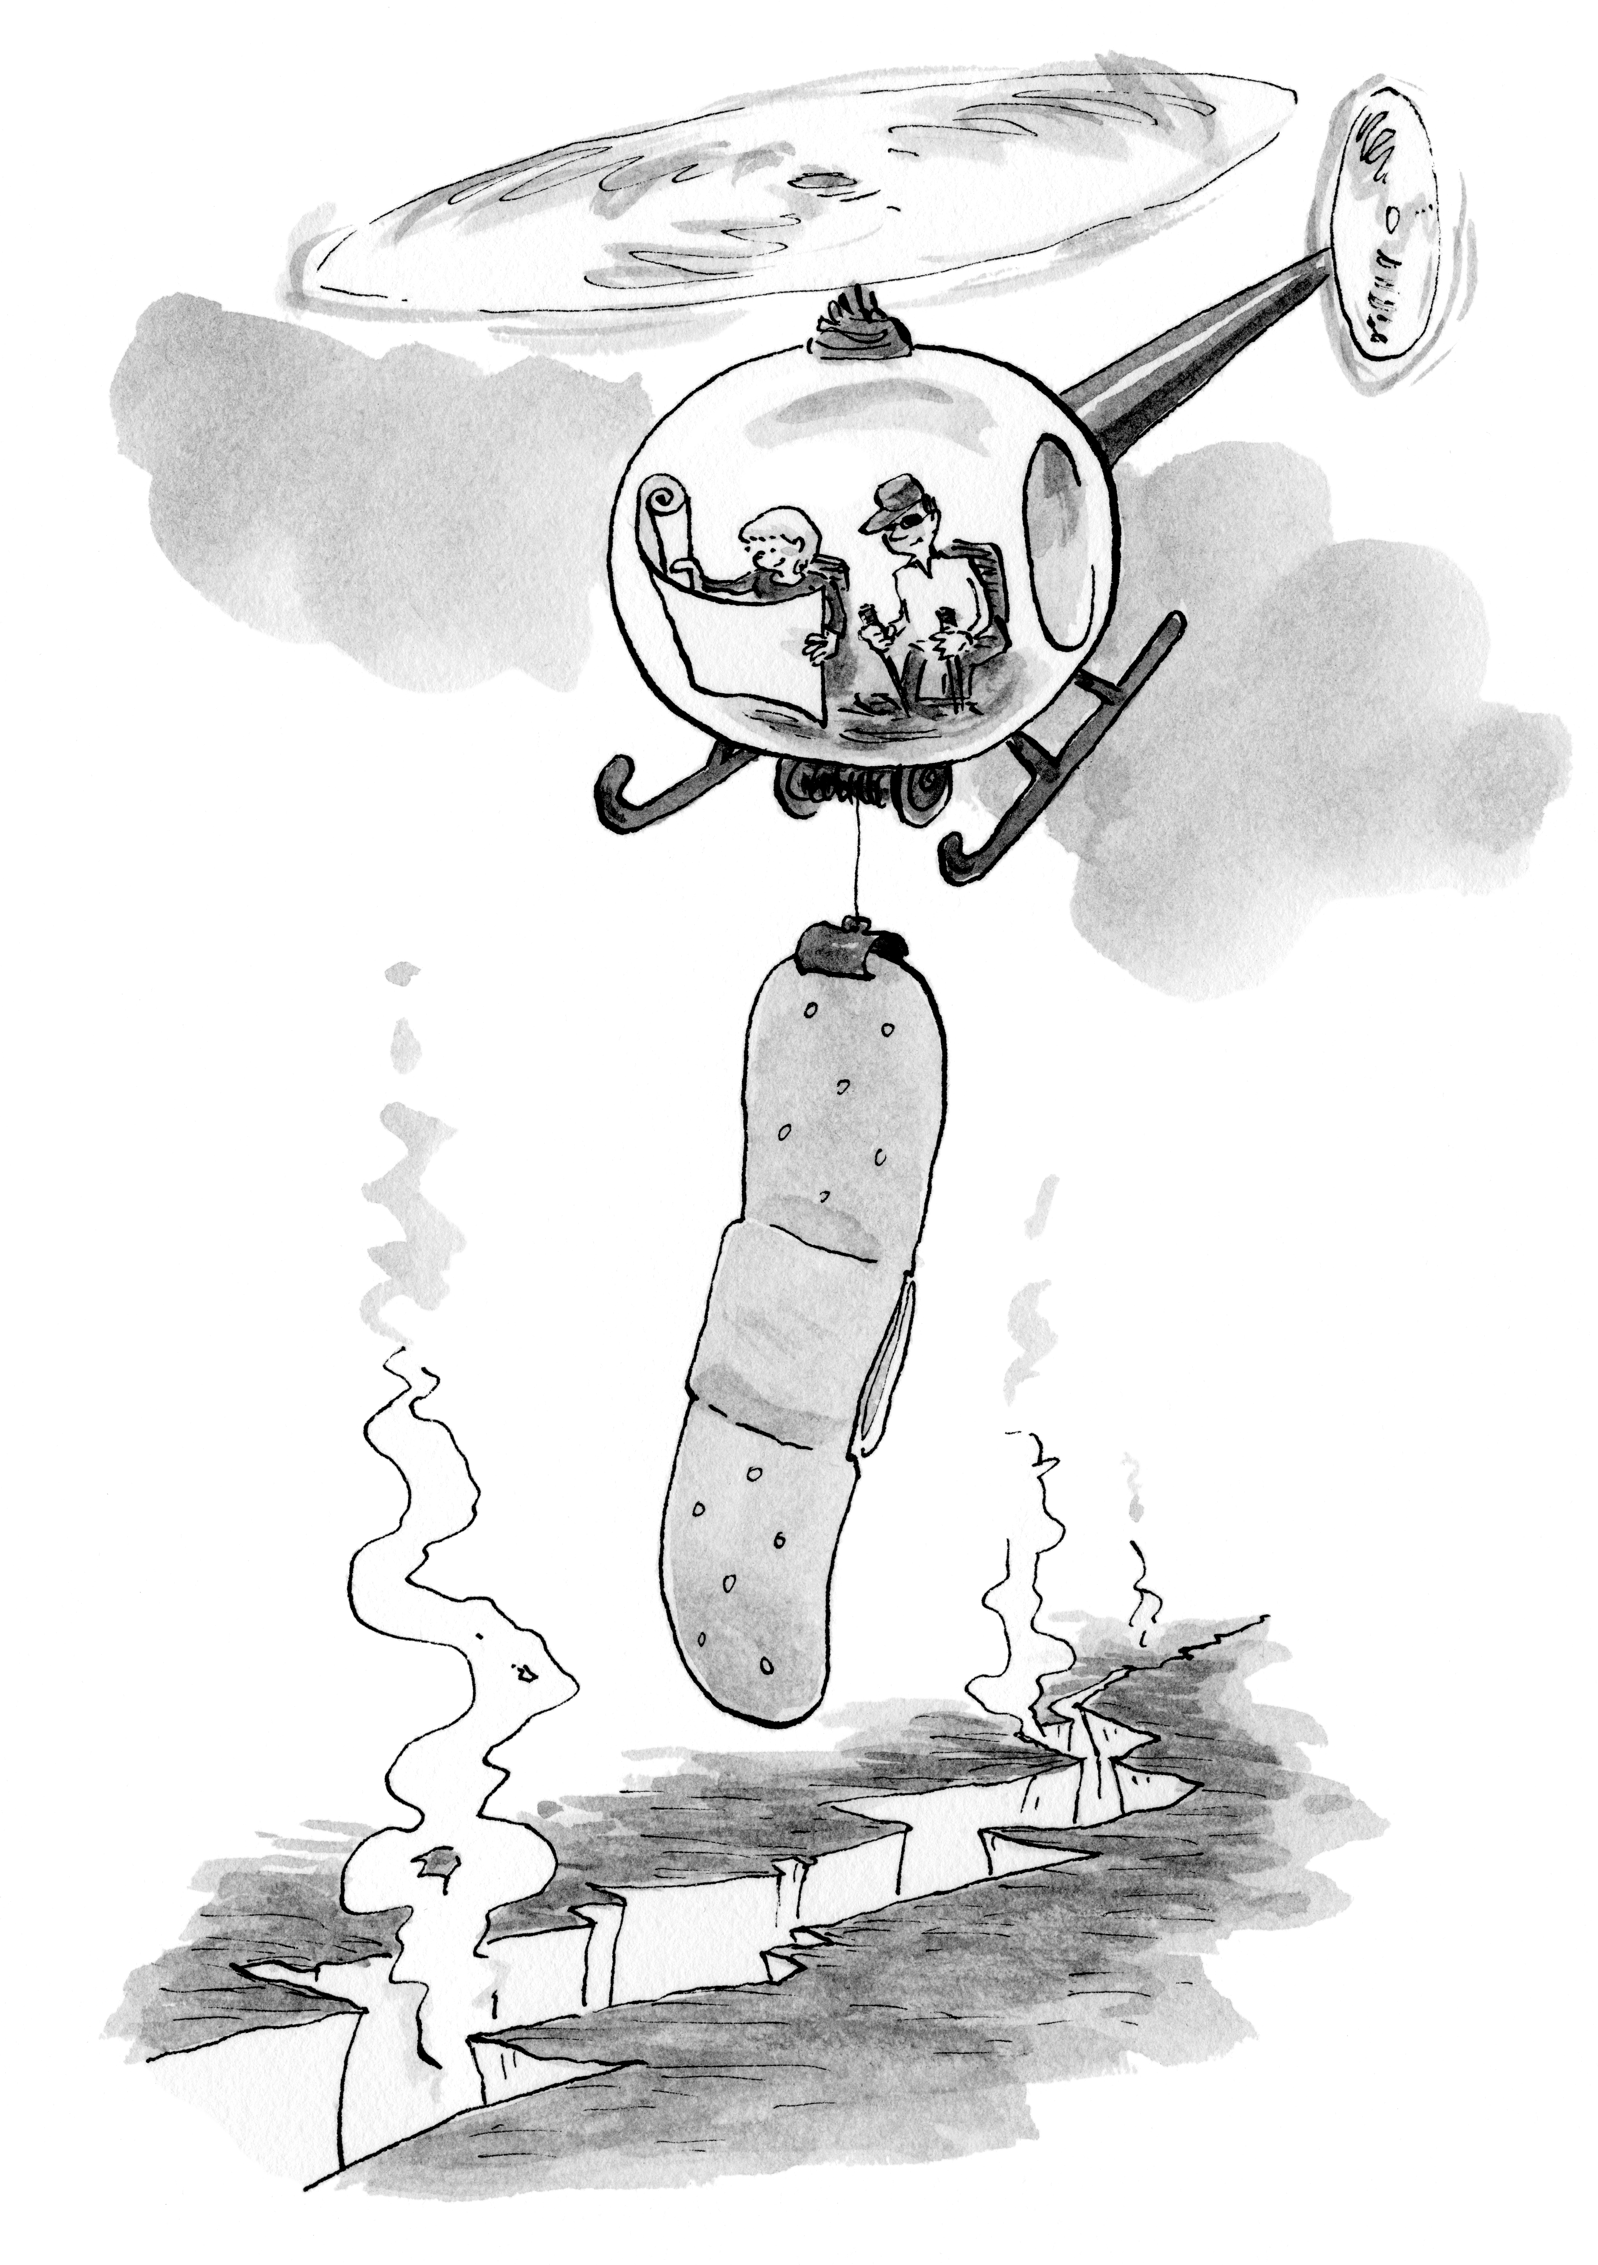
Notes:
Barriers to leadership:
Quick fixes don’t work
Our toughest challenges involve loss
Authority is never enough
Leadership is risky
Values class when you seek to close The Gap
The people in this room can help members of your community slow down; navigate loss and conflicting values…
To face tough challenges together
Knowing everyone has a piece of the puzzle
To see and seize their moments to lead

Slide 19
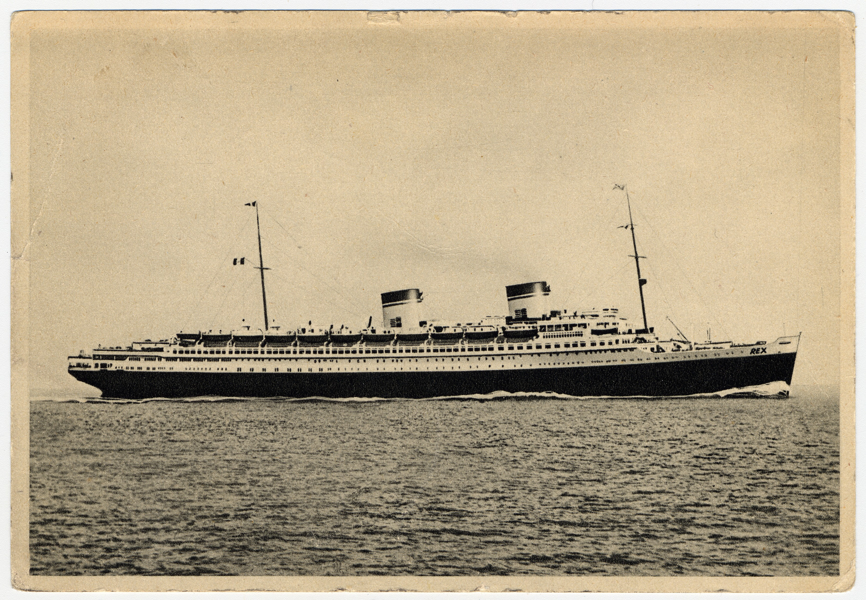

Slide 20
When Everyone Leads
We help one another assess risk and deal with loss.
We lean into conversations about conflicting values.
We see closing The Gap as something we each can influence.
We run more experiments.
We resist quick fixes and set better timetables.
Notes:
If that’s what we want, how do we get started?

Slide 21
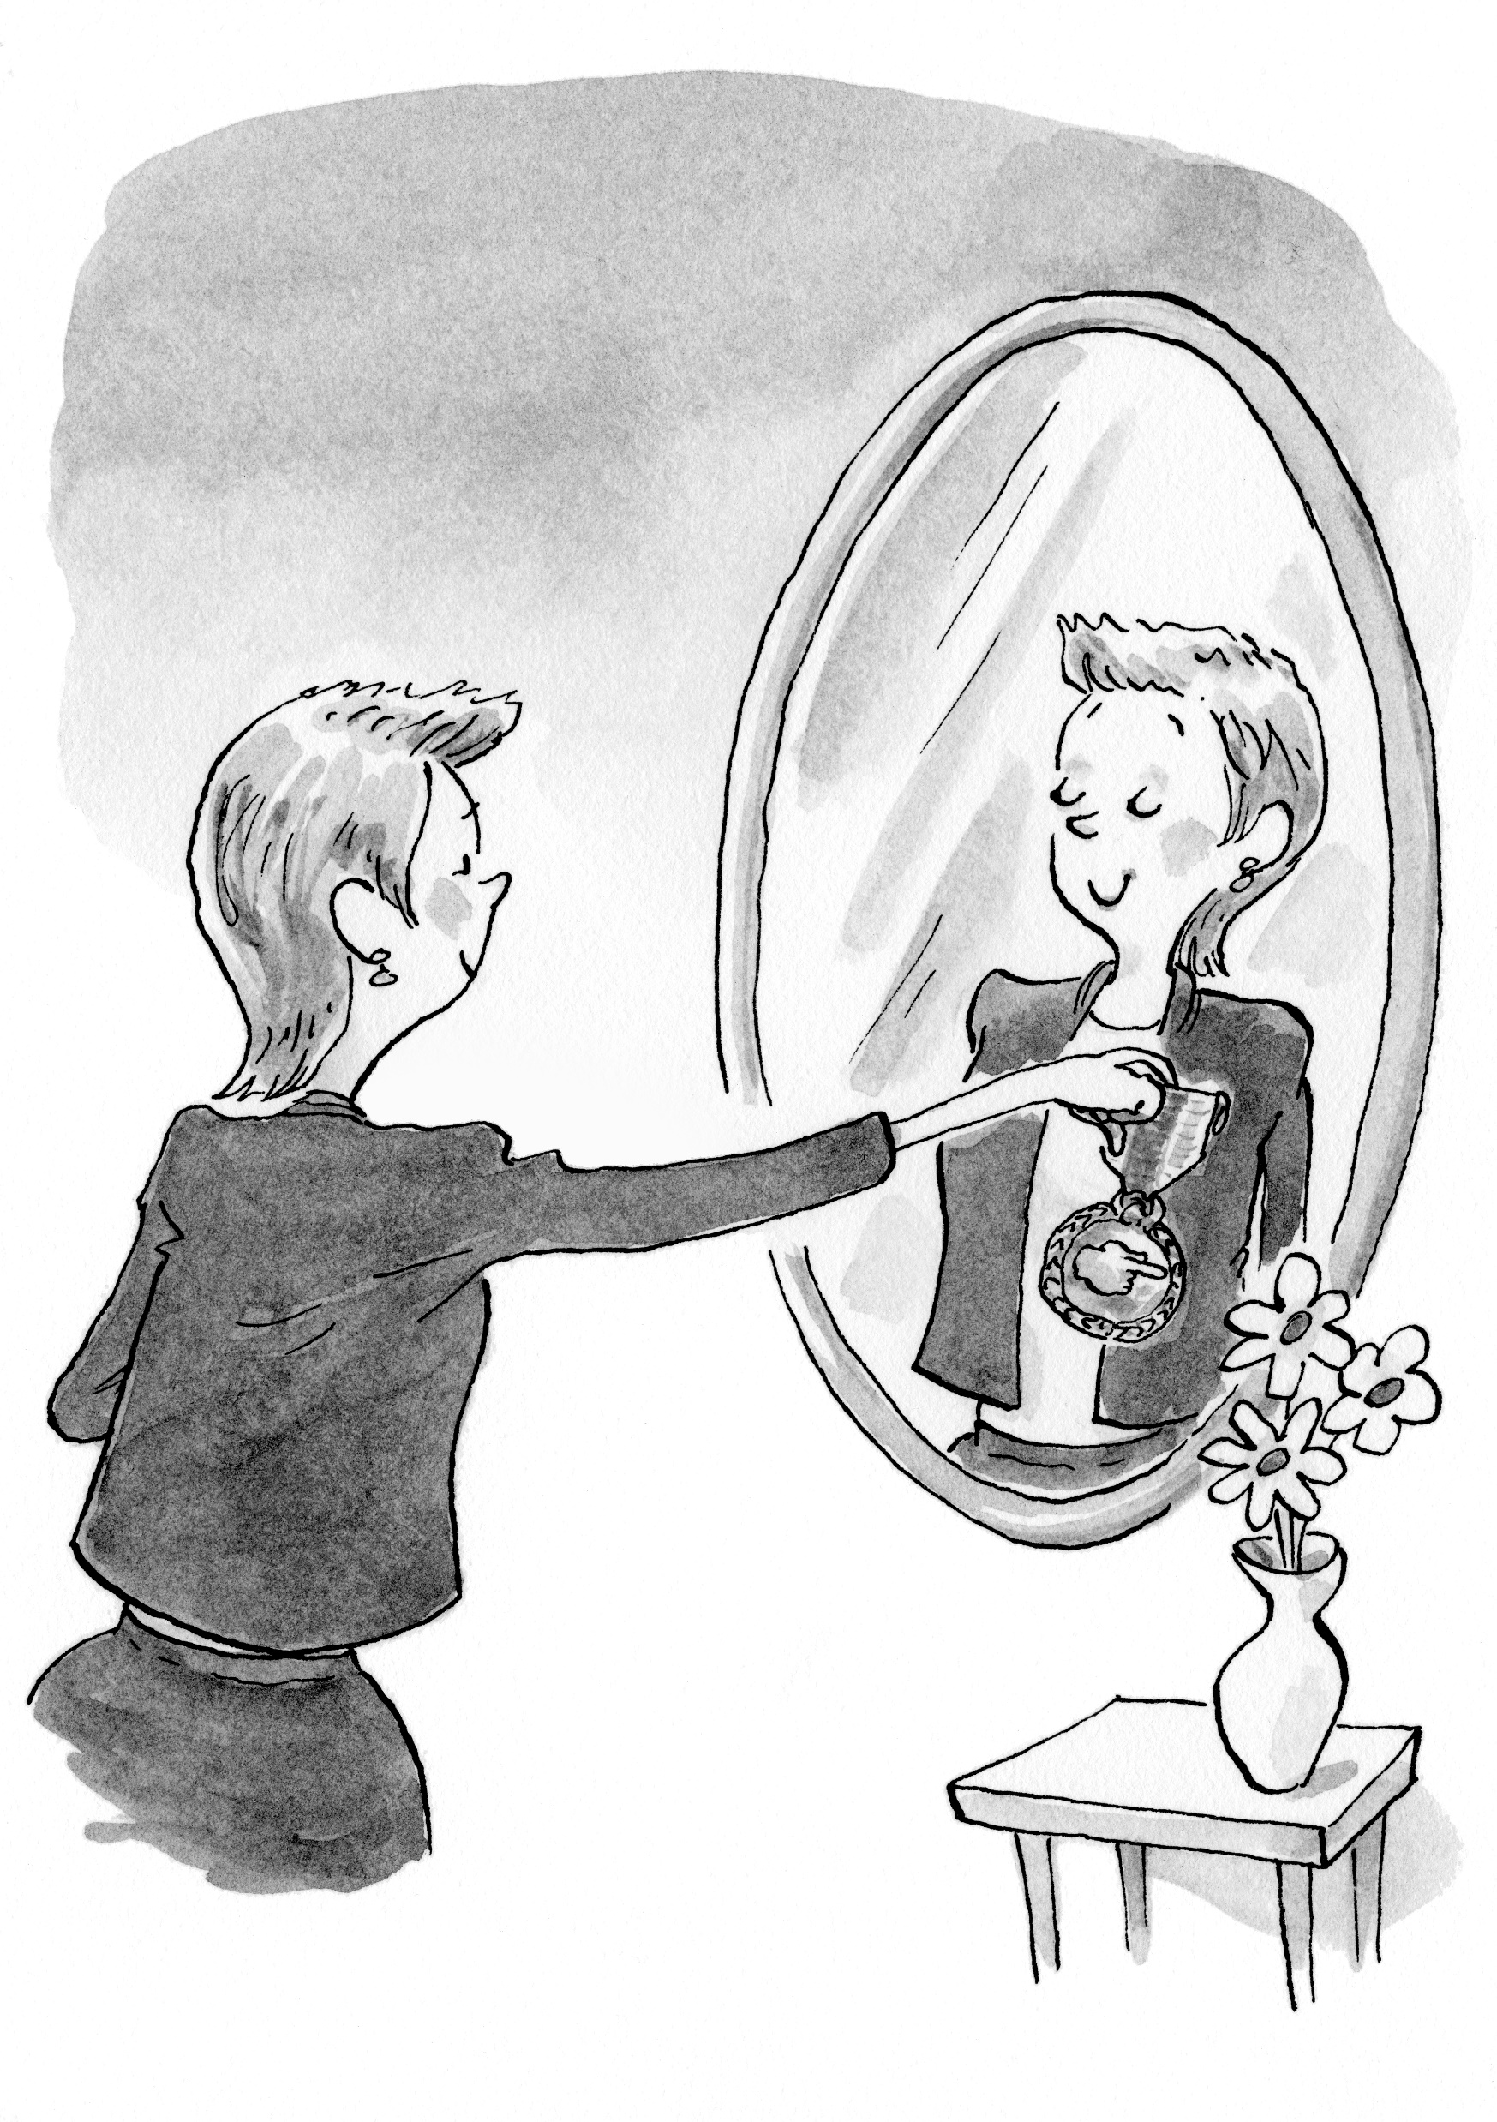
Start Authorizing Yourself to Lead
What holds you back from exercising leadership?
Notes:
If that’s what we want, how do we get started?

Slide 22
When Everyone Leads
You feel more engaged.
You feel empowered to make things better.
You seize more moments to move a group forward.
Notes:
If that’s what we want, how do we get started?

Slide 23
Notes:
If that’s what we want, how do we get started?

Slide 24
When Everyone Leads
Ask powerful questions.
Make tough interpretations.
Act experimentally.
Make leadership less risky for others.

Slide 25
You don’t need a title to start leading.
Notes:
Good morning
I’m Julia
I’m a Chase County Chamber Member
A Matfield Green Airbnb host
And proud member of that art-filled and welcoming flint hills community
Former actor
And co-author with Ed O’Malley of the new book When Everyone Leads: How the Toughest Challenges Get Seen and Solved.
My actor and writer selves came together in a really fun way when I spent 16 hours in a sound studio in Portland Oregon recording the audio version of this book.
And my acting training prepared me well a couple of key leadership behaviors that I’m going to leave you with today.

Slide 26
Which leadership principle stands out to you? Why?
1.
Leadership is
an activity,
not a position.
2.
Anyone can
lead, anytime, anywhere.
3.
Leadership
starts with you
and must
engage others.
4.
Leadership
is risky.
5.
Leadership
is about
our toughest challenges.
Notes:
Make the connection between that last principle and “challenge centric leadership”

Slide 27
When Everyone Leads
Around here, what issues have “good people been working on for a long time” without significant progress?
True or false: “The combination of major concerns and bold aspirations is like a powerful magnet energizing everyone’s leadership in a common direction?
Notes:
If that’s what we want, how do we get started?

Slide 28
Which barrier to leadership gets in your way most?
How do you get around it?
1.
Our toughest challenges involve loss.
2.
Values clash when you seek to close The Gap.
3.
Quick fixes don’t work.
4.
Authority is never enough to close The Gap.
5.
Leadership is risky.
Notes:
Make the connection between that last principle and “challenge centric leadership”

Slide 29
When Everyone Leads
“We are pushing a new model for leadership…The old person-centric model doesn’t solve big, hairy 21st century problems.”
Do you agree? How important is it to understand and adopt a challenge-centric leadership model?
Notes:
If that’s what we want, how do we get started?

Slide 30
When Everyone Leads
“Exercising leadership involves taking the temperature and regulating the flame.”
What is hard about finding a middle place where there is just enough heat to generate progress?
Notes:
If that’s what we want, how do we get started?

Slide 31
When Everyone Leads
How would you describe what it means to “act experimentally?”
What will you do differently as a result of today’s discussion?
Notes:
If that’s what we want, how do we get started?

Slide 32
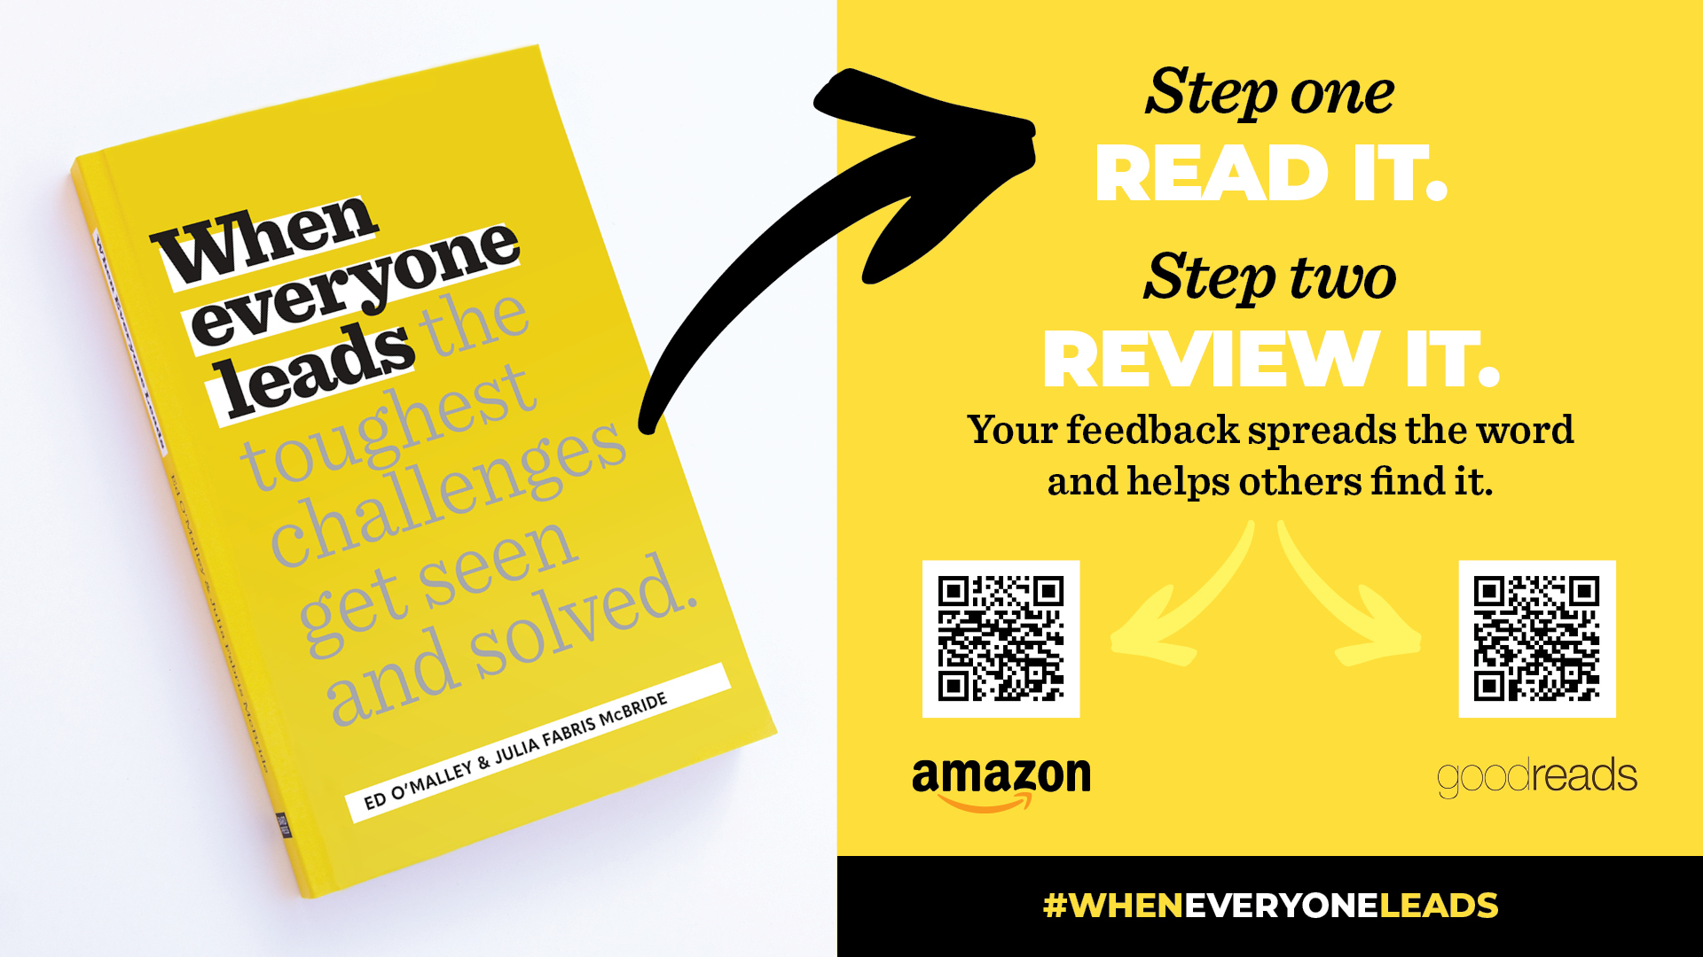

Slide 33


Slide 34
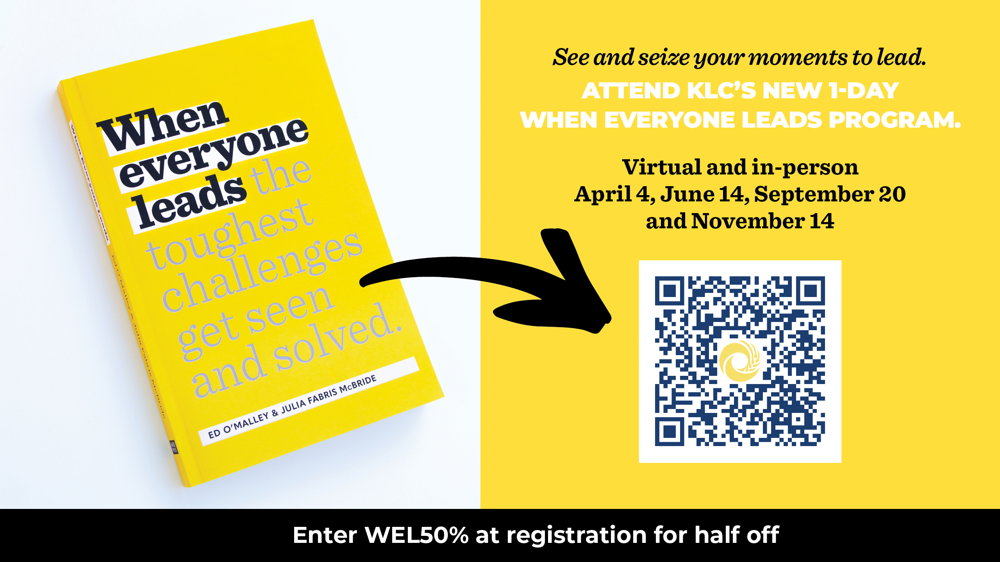
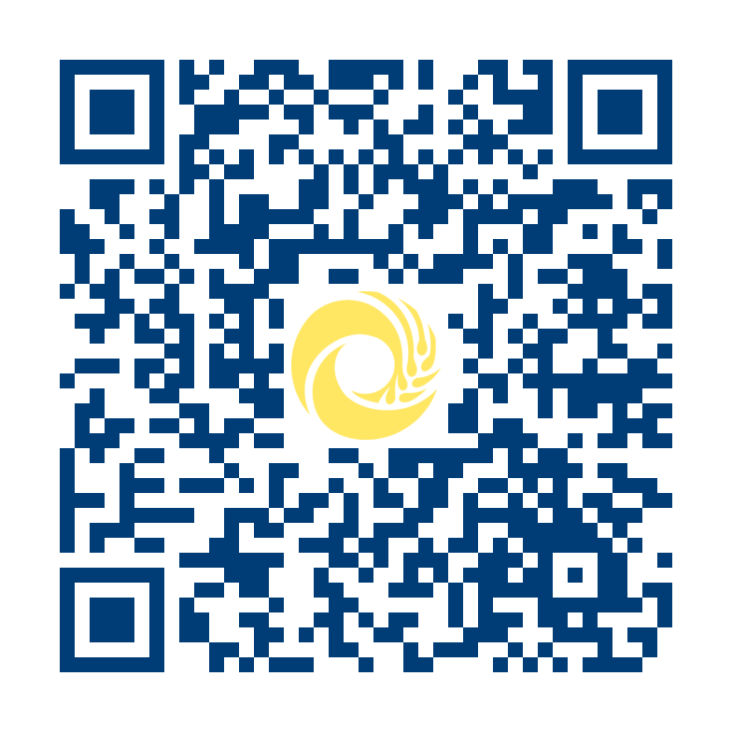
See and seize your moments to lead.
Attend KLC’s new 1-day When Everyone Leads program.
Virtual and in-person April 4
June 14
September 20
November 14

